Slide 1
BAYESIAN LEARNING
Bayesian Classifiers
Bayesian classifiers are statistical classifiers, and are based on Bayes theorem
They can calculate the probability that a given sample belongs to a particular class

Slide 2
BAYESIAN LEARNING
Bayesian learning algorithms are among the most practical approaches to certain types of learning problems.
There results are comparable to the performance of other classifiers, such as decision tree and neural networks in many cases

Slide 3
BAYESIAN LEARNING
Bayes Theorem
Let X be a data sample, e.g. red and round fruit
Let H be some hypothesis, such as that X belongs to a specified class C (e.g. X is an apple)
For classification problems, we want to determine P(H|X), the probability that the hypothesis H holds given the observed data sample X

Slide 4
BAYESIAN LEARNING
Prior & Posterior Probability
The probability P(H) is called the prior probability of H, i.e the probability that any given data sample is an apple, regardless of how the data sample looks
The probability P(H|X) is called posterior probability. It is based on more information, then the prior probability P(H) which is independent of X

Slide 5
BAYESIAN LEARNING
Bayes Theorem
It provides a way of calculating the posterior probability
P(H|X) = P(X|H) P(H)
P(X)
P(X|H) is the posterior probability of X given H (it is the probability that X is red and round given that X is an apple)
P(X) is the prior probability of X (probability that a data sample is red and round)

Slide 6
BAYESIAN LEARNING
Naïve (Simple) Bayesian Classification
Studies comparing classification algorithms have found that the simple Bayesian classifier is comparable in performance with decision tree and neural network classifiers
It works as follows:
1. Each data sample is represented by an n-dimensional feature vector, X = (x₁, x₂, …, x_{n}), depicting n measurements made on the sample from n attributes, respectively A₁, A₂, … A_{n}

Slide 7
BAYESIAN LEARNING
Naïve (Simple) Bayesian Classification
2. Suppose that there are m classes C₁, C₂, … C_{m}. Given an unknown data sample, X (i.e. having no class label), the classifier will predict that X belongs to the class having the highest posterior probability given X
Thus if P(C_{i}|X) > P(C_{j}|X) for 1 ≤ j ≤ m , j ≠ i
then X is assigned to C_{i}
This is called Bayes decision rule

Slide 8
BAYESIAN LEARNING
Naïve (Simple) Bayesian Classification
3. We have P(C_{i}|X) = P(X|C_{i}) P(C_{i}) / P(X)
As P(X) is constant for all classes, only P(X|C_{i}) P(C_{i}) needs to be calculated
The class prior probabilities may be estimated by
P(C_{i}) = s_{i} / s
where s_{i} is the number of training samples of class C_{i}
& s is the total number of training samples

Slide 9
BAYESIAN LEARNING
Naïve (Simple) Bayesian Classification
4. Given data sets with many attributes, it would be extremely computationally expensive to compute P(X|C_{i})
For example, assuming the attributes of colour and shape to be Boolean, we need to store 4 probabilities for the category apple
P(¬red ∧ ¬round | apple)
P(¬red ∧ round | apple)
P(red ∧ ¬round | apple)
P(red ∧ round | apple)
If there are 6 attributes and they are Boolean, then we need to store 2⁶ probabilities

Slide 10
BAYESIAN LEARNING
Naïve (Simple) Bayesian Classification
In order to reduce computation, the naïve assumption of class conditional independence is made
This presumes that the values of the attributes are conditionally independent of one another, given the class label of the sample (we assume that there are no dependence relationships among the attributes)

Slide 11
BAYESIAN LEARNING
Naïve (Simple) Bayesian Classification
Thus we assume that P(X|C_{i}) = ∏^{n}_{k=1} P(x_{k}|C_{i})
Example
P(colour ∧ shape | apple) = P(colour | apple) P(shape | apple)
For 6 Boolean attributes, we would have only 12 probabilities to store instead of 2⁶ = 64
Similarly for 6, three valued attributes, we would have 18 probabilities to store instead of 3⁶

Slide 12
BAYESIAN LEARNING
Naïve (Simple) Bayesian Classification
The probabilities P(x₁|C_{i}), P(x₂|C_{i}), …, P(x_{n}|C_{i}) can be estimated from the training samples, where
For an attribute A_{k}, which can take on the values x_{1k}, x_{2k}, …
e.g. colour = red, green, …
P(x_{k}|C_{i}) = s_{ik}/s_{i}
where s_{ik} is the number of training samples of class C_{i} having the value x_{k} for A_{k}
and s_{i} is the number of training samples belonging to C_{i}
e.g. P(red|apple) = 7/10 if 7 out of 10 apples are red

Slide 13
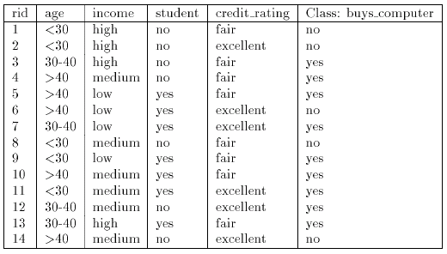
BAYESIAN LEARNING
Naïve (Simple) Bayesian Classification
Example:

Slide 14
BAYESIAN LEARNING
Naïve (Simple) Bayesian Classification
Example:
Let C₁ = class buy computer and C₂ = class not buy computer
The unknown sample:
X = {age = ≤ 30, income = medium, student = yes, credit-rating = fair}
The prior probability of each class can be computed as
P(buy computer = yes) = 9/14 = 0.643
P(buy_computer = no) = 5/14 = 0.357

Slide 15
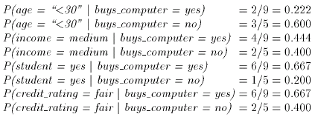
BAYESIAN LEARNING
Naïve (Simple) Bayesian Classification
Example:
To compute P(X|Ci) we compute the following conditional probabilities

Slide 16
BAYESIAN LEARNING
Naïve (Simple) Bayesian Classification
Example:
Using the above probabilities, we obtain
And hence the naïve Bayesian classifier predicts that the student will buy computer, because

Slide 17
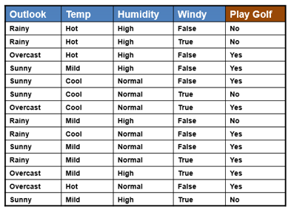
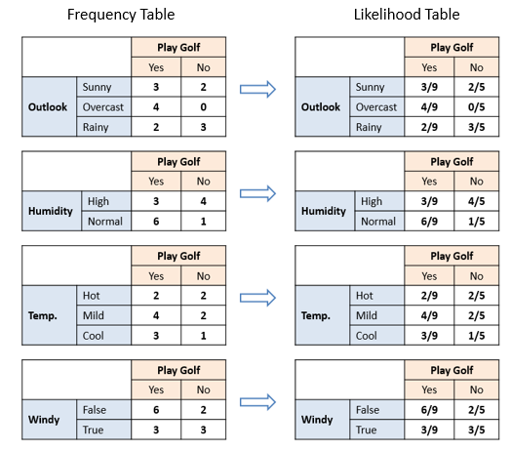
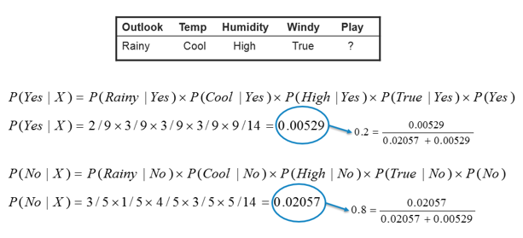

Slide 18
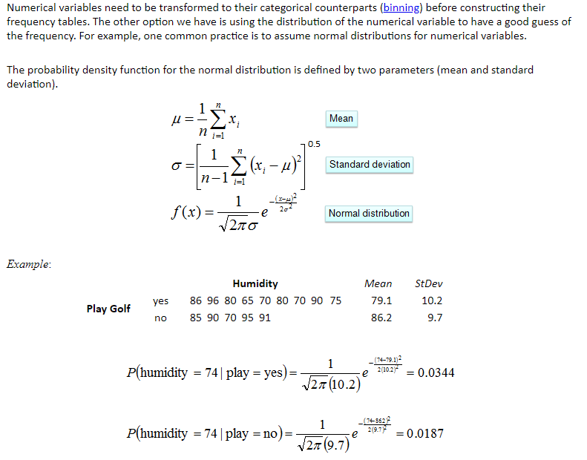
Gaussian Naïve Bayes Classifier

Slide 19
The Zero-Frequency Problem
One of the disadvantages of Naïve Bayes is that if you have no occurrences of a class label and a certain attribute value together then the frequency-based probability estimate will be zero. And this will get a zero when all the probabilities are multiplied.

Slide 20
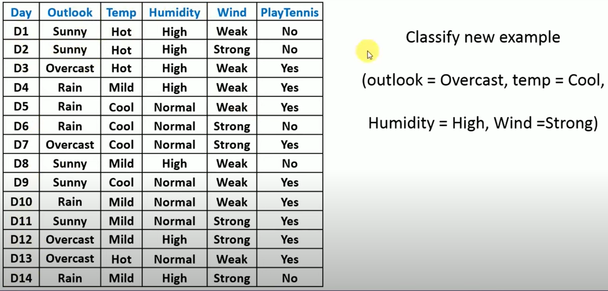
Laplace smoothing or correction for handling zero frequency problem

Slide 21
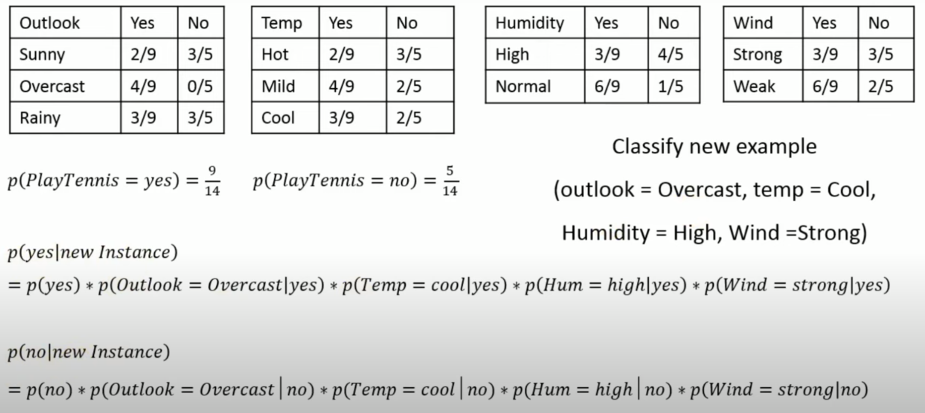
Laplace smoothing or correction for handling zero frequency problem

Slide 22
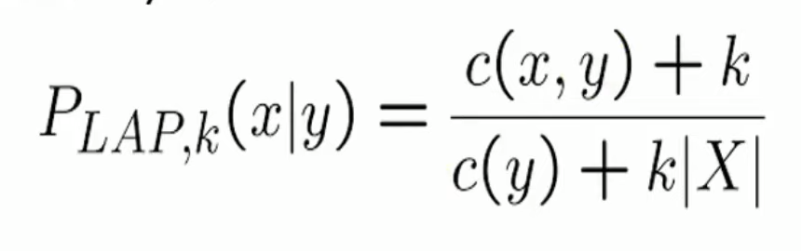
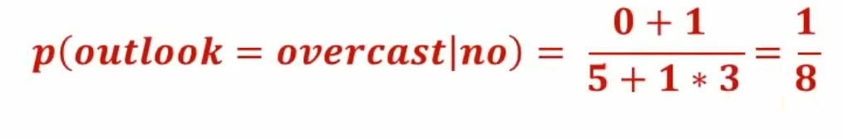
Laplace smoothing or correction
Laplace smoothing is a smoothing technique that handles the problem of zero probability in Naïve Bayes.
K represents the smoothing parameter (greater than zero)
X represent number of different values x can have

Slide 23
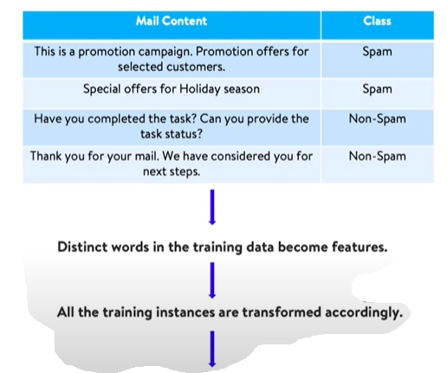
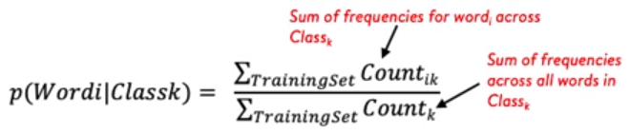

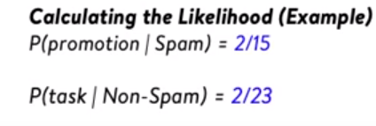
Multinomial Naïve Bayes Classifier

Slide 24
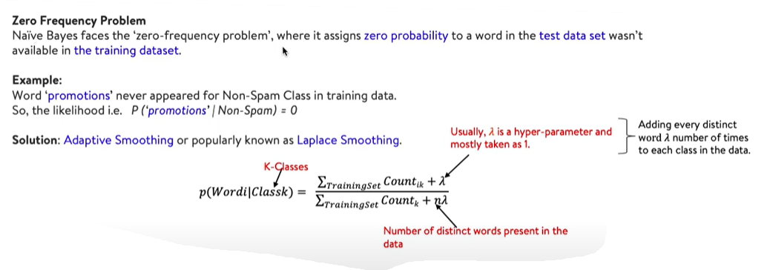
Multinomial Naïve Bayes Classifier

